Slide 1
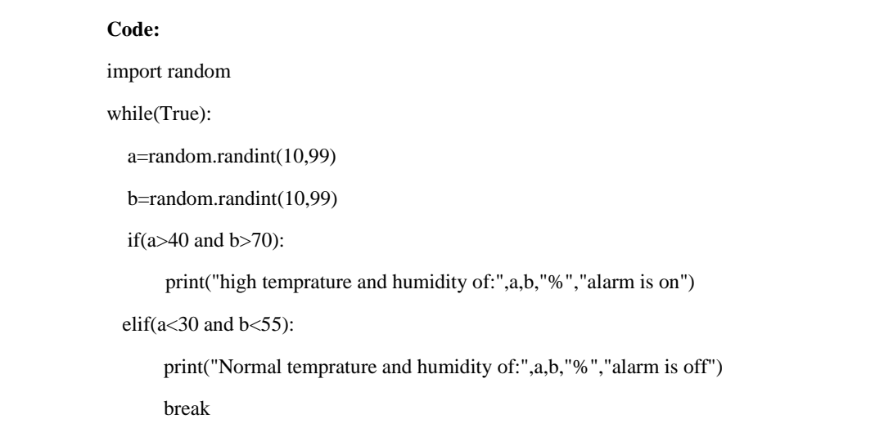
ASSIGNMENT NO -2
Project Name :
Batch Number:
Assignment Topic : Assignment on temperature and humidity sensing and alarm automation using python
TEAM MEMBERS
Team lead : Member-1 : Member-2 : Member-3 :

Slide 2
